Slide 1



Team BitBites
Joel Park, Akshaya Subramanian, Tianhao Zhao, and Franklin Zhang
CSM117 Spring 2016
June 1, 2016
Notes:
ALL

Slide 2
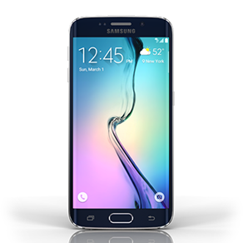

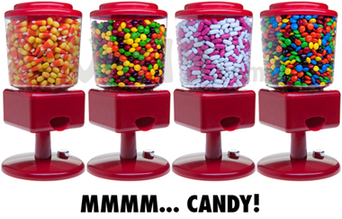

Abstract
Motivation:
Learn Bluetooth
Create a cool project
Goals:
Bluetooth activated dispenser
Android App to pick selections
Mobile Payment in the future
Materials
Android Phone for user interface
Dispensing apparatus
Candy
Servo / Stepper Motor
Raspberry Pi (Bluetooth receiver + activate motors)
Notes:
Joel

Slide 3
Theory
User Interface
Bluetooth Data Transmission
Bluetooth Receiver
Candy
Dispensing Apparatus
Servo
Notes:
Joel

Slide 4
Team Work Distribution
Joel Park: Android Application Development
Created Graphic User Interface
Franklin Zhang: Android Application Development
Android Bluetooth to Raspberry Pi, High level integration
Tianhao Zhao: Raspberry Pi
Worked on receiving signals from App and sending signals to servo
Akshaya Subramanian: Physical Structure and Servo
Built structure and worked on dispensing mechanism
Notes:
Joel

Slide 5
Android Application
Android Studio development environment
Compiled and tested on S7, and Nexus 6
Testing: Blueterm
Verify presence of Bluetooth adapter, change adapter state, connect and send data on Bluetooth.
Notes:
Franklin

Slide 6
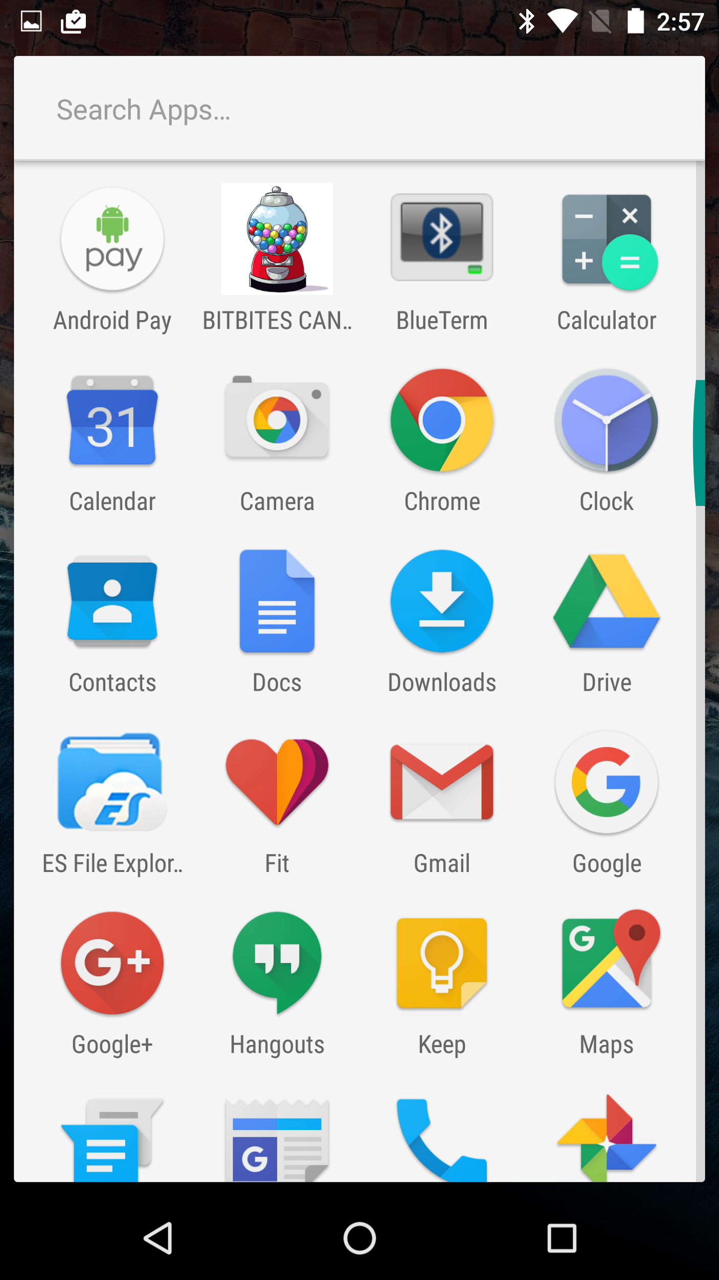
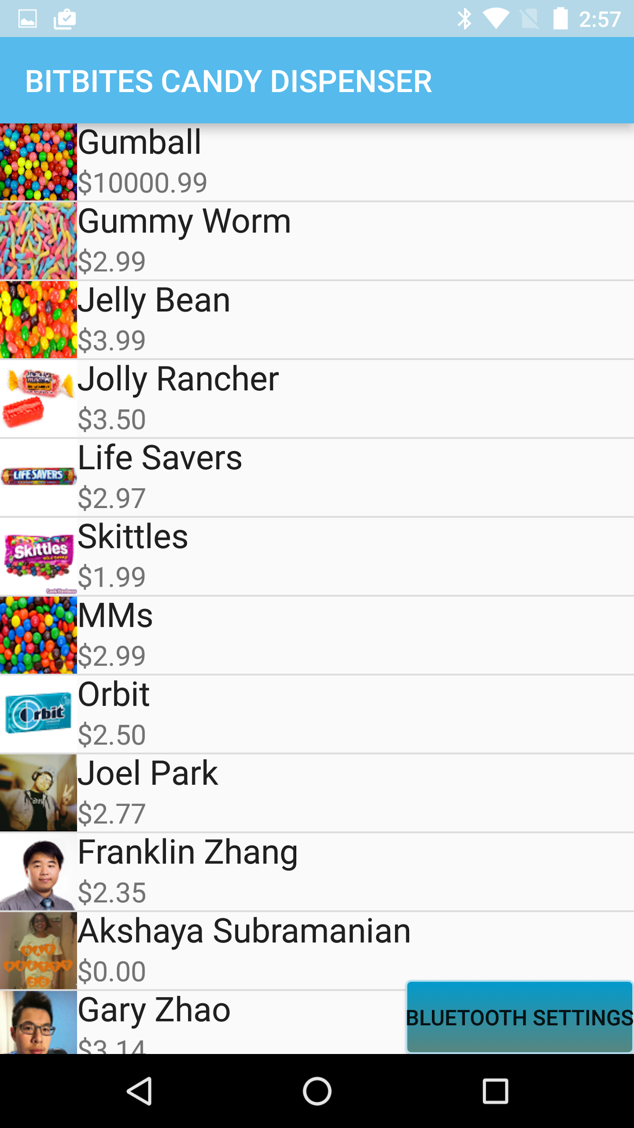
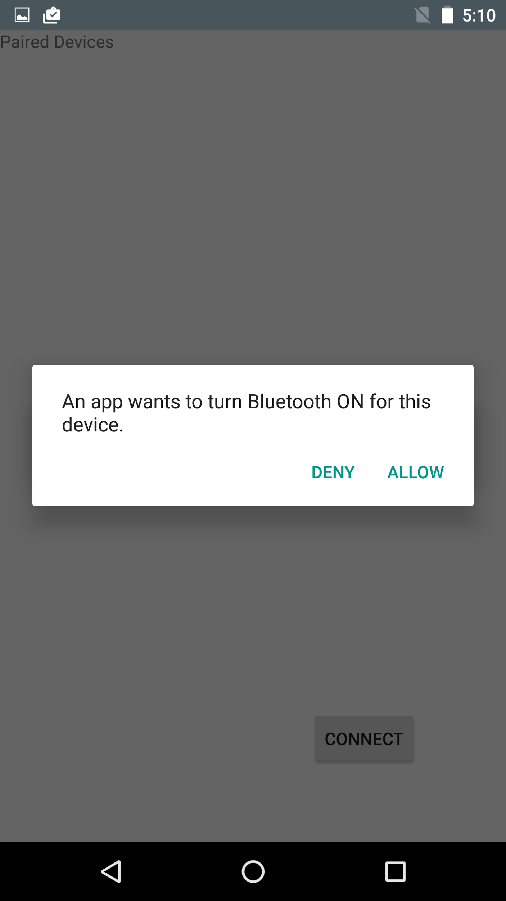
Android Application
Notes:
Franklin

Slide 7
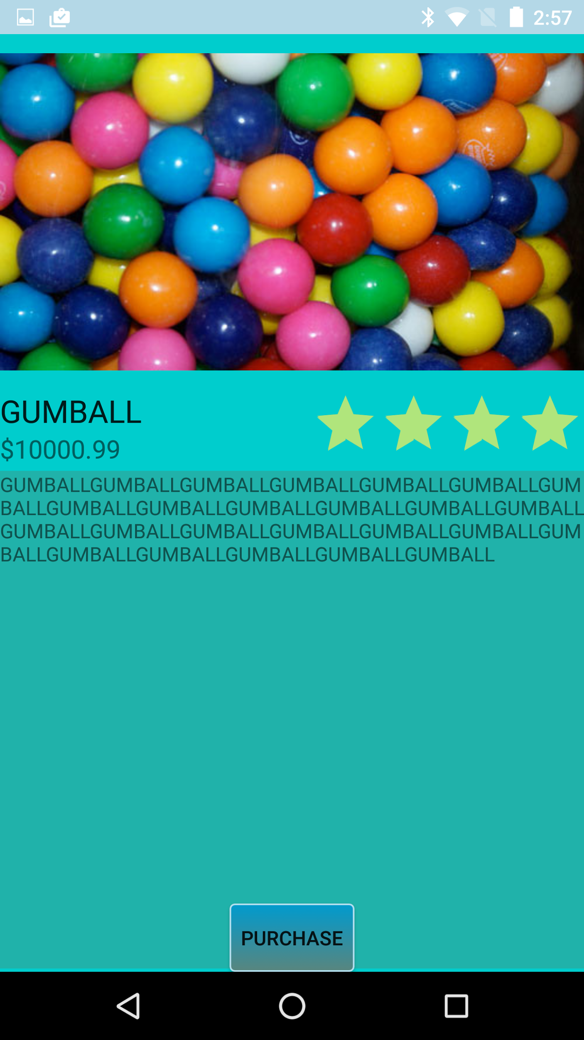
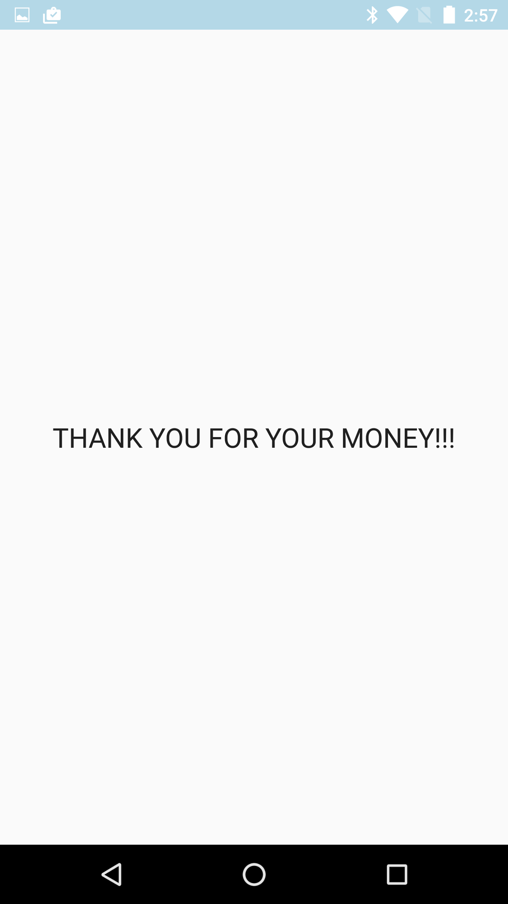
Android Application
Notes:
Franklin

Slide 8
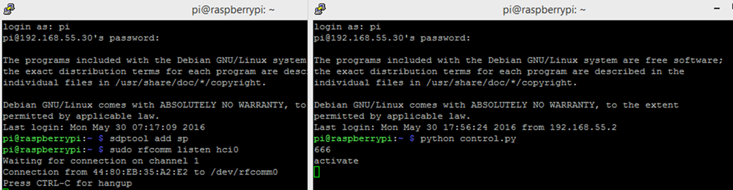
Raspberry Pi
Coded in Python
Connects to Android Phone by using rfcomm
Reads message through Python Serial library
Servo Control: Use duty cycle percentage to adjust angles
Notes:
Gary

Slide 9
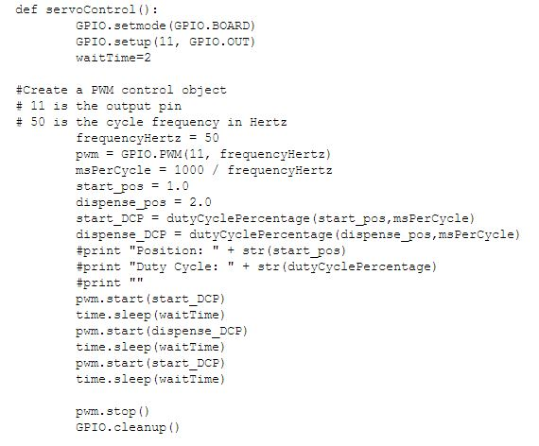
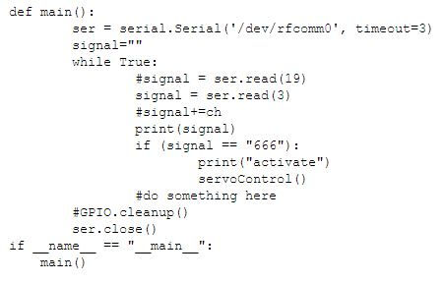
Raspberry Pi Code
Notes:
Gary

Slide 10
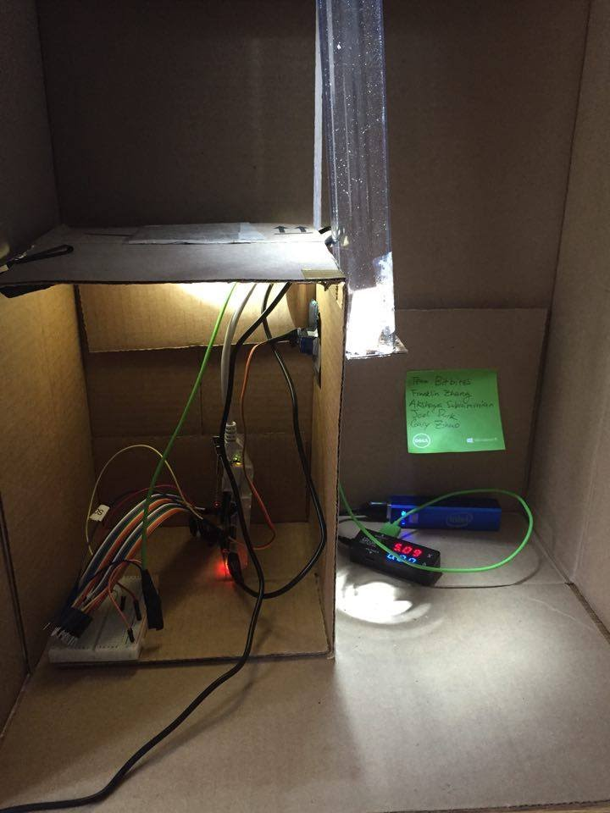
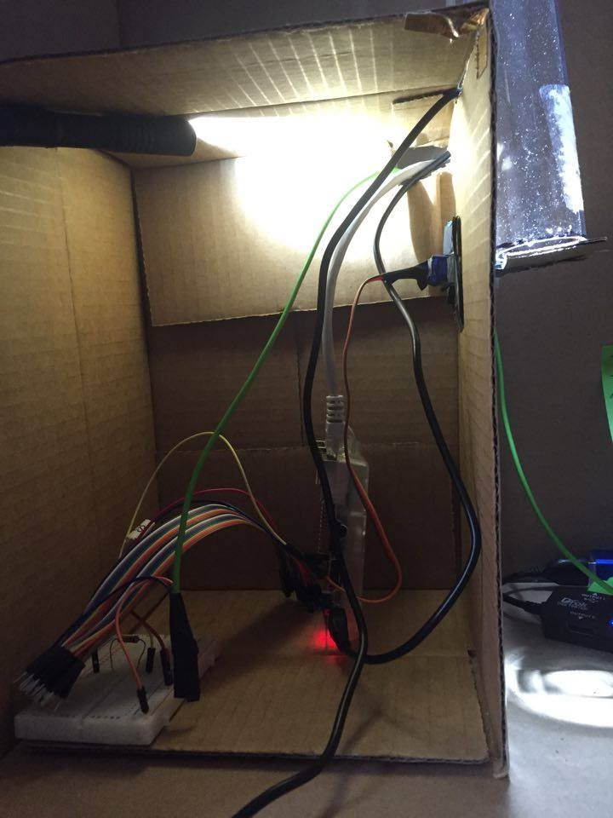
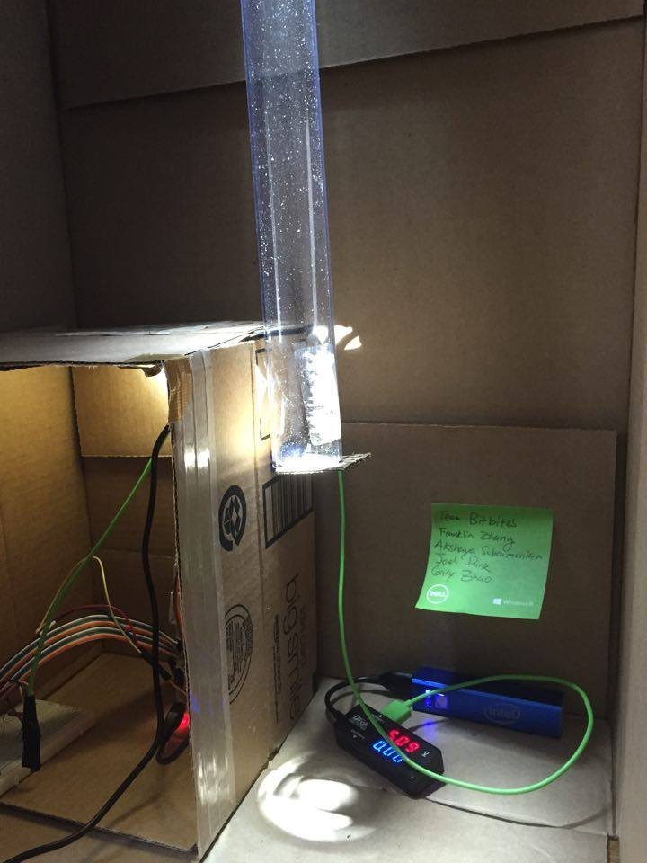
Physical Set-Up
Dispenser Tube
Servo
Flapper
Raspberry Pi
Overall Set Up
Notes:
Akshaya

Slide 11

DEMO
https://www.youtube.com/watch?v=sStwDj6lKY8&feature=youtu.be

Slide 12
Results
Able to program Android Application (used for servo testing)
Able to change adapter state with app
Able to send command from App to Raspberry Pi via Bluetooth
Able to use Raspberry Pi GPIO to control servo and activate flap
Able to dispense candy
Notes:
Akshaya

Slide 13
Problems
Bluetooth not enabled by default, must manually update OS and install it
Lack of good documentation on Android Studio and Raspberry Pi
Bluetooth is finicky
Android Studio has a steep learning curve and takes a while to get up to speed
Physical parts fail
Pairing process on pi doesn’t use gui, but rather different terminal commands
Type “y” instead of “yes” rejects pairing key
Notes:
Akshaya

Slide 14
Conclusion
Successfully able to dispense candy
Learned Android has steep learning curve
Very easy to fry servos
Raspberry Pi Bluetooth setup is non-trivial
Programming apps to use Bluetooth is complex
Notes:
Gary

Slide 15
Future Plans
Be able to dispense multiple types of candies
Make app run more smoothly
Be able to control the number of candies dispensed
Delivery system: have a robot bring the candy to you
Tamper resilience
Mobile Payments
QR / NFC Pairing
Internet of Things, sales and supply monitoring
Notes:
Gary

